Slide 1


Match Longevity Improvement Analysis
Team: We Push to Prod

Slide 2



Why are we here?
Situation
Complication
Big Brothers Big Sisters – Twin Cities pairs youth with volunteer mentors to foster supportive, lasting relationships, resulting in greater educational attainment, reduced socioeconomic gaps, and up to 20% higher lifetime earnings. Strong matches are key to sustaining this long-term positive impact.
Most matches end prematurely despite mentor support, limiting lasting impact on youth. With limited visibility into success drivers and multiple hard-to-measure factors, sustaining long, impactful matches remains challenging.
BIG BROTHER BIG SISTER

Slide 3
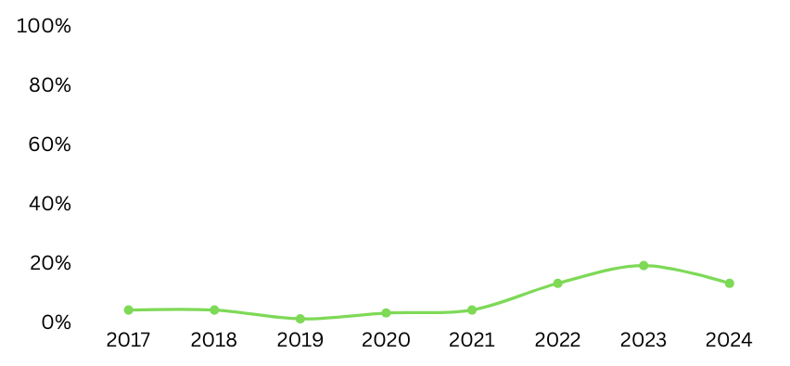
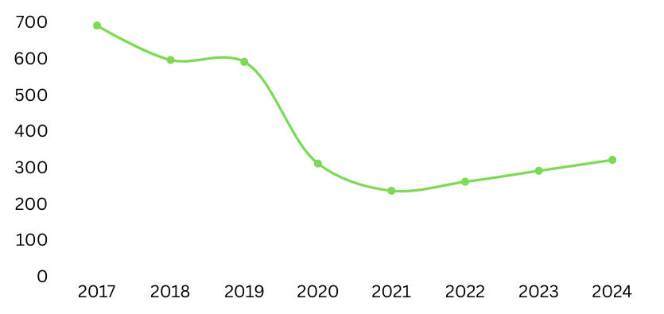
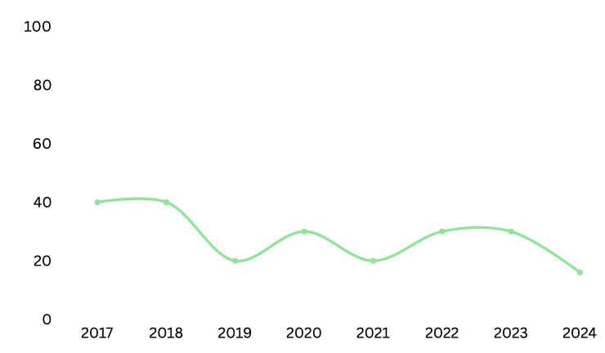
Complications: Key Numbers from Data
Positive Closures (%)
Only ~7% of all closed matches had positive/planned closures
New matches by Year
New Matches per Year fell by ~50% due to COVID, but are now rising at 5% YoY post-pandemic
1 Year Churn Rate (%)
38% of closed matches closed in less than a year historically
Notes:
Pre-covid: peaked in 2018 to 40%, followed by a sharp drop in 2019
Churn rate: Post covid: spiked around 35% in 2022, dropping gradually and halving in 2024

Slide 4

Why are we here?
Situation
Complication
Key Question
Big Brothers Big Sisters – Twin Cities pairs youth with volunteer mentors to foster supportive, lasting relationships, resulting in greater educational attainment, reduced socioeconomic gaps, and up to 20% higher lifetime earnings. Strong matches are key to sustaining this long-term positive impact.
Most matches end prematurely despite mentor support, limiting lasting impact on youth. With limited visibility into success drivers and multiple hard-to-measure factors, sustaining long, impactful matches remains challenging.
How can we use structured and unstructured data to pinpoint the key demographic, behavioral, and emotional factors influencing match length and closure, and then develop targeted interventions to improve match success rates?
BIG BROTHER BIG SISTER

Slide 5






Data Notes
Data Sources
BBBS – TC Training Data
Census Data (2022)
Data Processing
Lost Contact
33
Closure Reasons
10 Closure Reasons Groups
Relocation/Move
Key Closure Reasons Groups
Child Family Changed Circumstances
Time Constraints
Relationship Incompatibility
Policy/Expectation Issues

Slide 6
Our Solution
Match Phase
Matching (match based on success factors)
Current Matches
Post-Closure (Unsuccessful closure)
Questions to gauge potential match closure
Prediction Model
Intervention Strategy
Matching (match based on success factors)

Slide 7
Our Solution
Match Phase
Matching (match based on success factors)
Current Matches
Post-Closure (Unsuccessful closure)
Questions to gauge potential match closure
Prediction Model
Intervention Strategy

Slide 8
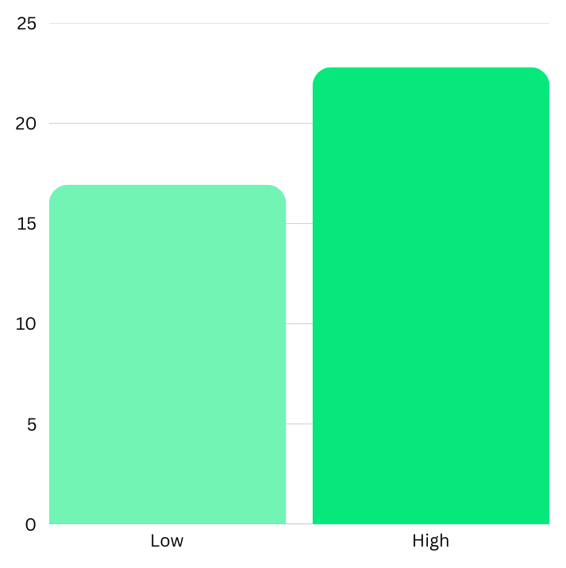
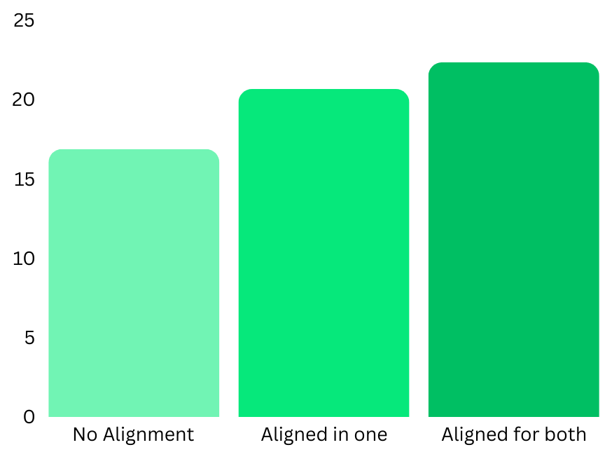
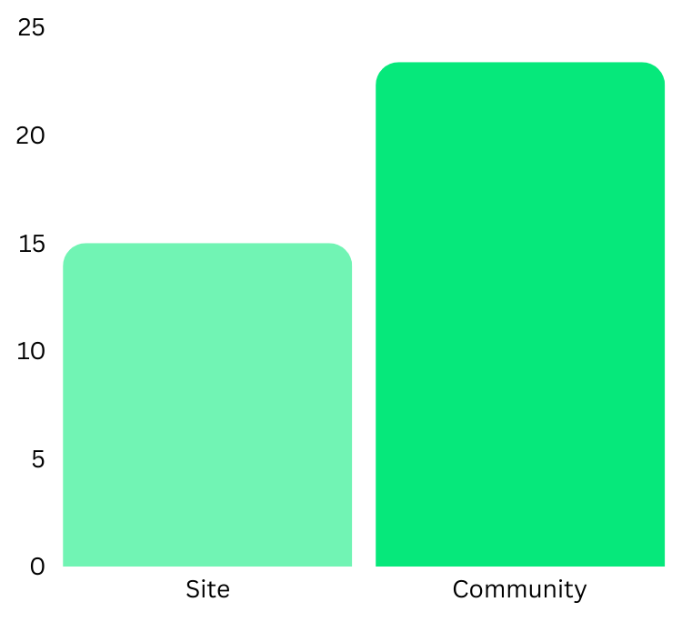
Key factors contributing towards longer matches
Age Difference vs match length
Alignment on ethnicity & gender vs match length
Demographics
Match length
Matches with an age difference >18 years tend to last ~7 months longer on average
Matches where at least 1 of the ethnicity or gender align tend to be longer by ~5 months on average
Community matches have ~9 months longer matches compared to Site matches
Other factors
Match length
Program Type
Emotional Tones

Slide 9
Matching-Model with key factors facilitate match success
Closed matches closely follow positive match length trends for identified key factors
Total Demographics aligned on | Has Shared Interests? | Age Difference > 18 | Average Match Length | % of Total Closed Matches (2.5K)
2 | Yes | Yes | 26 | 10%
2 | Yes | - | 20 | 3%
2 | - | Yes | 23 | 4%
2 | - | - | 15 | 4%
1 | Yes | Yes | 22 | 31%
1 | Yes | - | 18 | 13%
1 | - | Yes | 23 | 19%
1 | - | - | 17 | 13%
- | Yes | Yes | 23 | 2%
- | Yes | - | 13 | 1%
- | - | Yes | 15 | 1%
- | - | - | 12 | 1%
Optimal match conditions
24.1
20.8
75% of closed matches were sub-optimally matched
Sub-optimal match conditions
16.9
Future Matches should be done based on optimal match conditions to facilitate longer lasting matches

Slide 10

Our Solution
Match Phase
Matching (match based on success factors)
Current Matches
Post-Closure (Unsuccessful closure)
Questions to gauge potential match closure
Prediction Model
Intervention Strategy

Slide 11
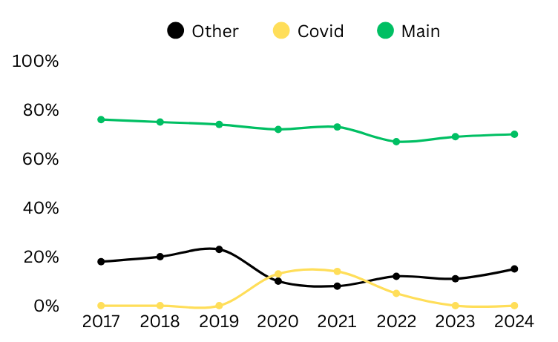




Factors contributing to major closure reasons
% of total
Match Support: Emotions
Closure Description: Keywords
Lost Contact
20%
Annoyal
B – Got busy, lost interest
L – Not reachable, re-enroll
(17%)
(73%)
Relocation
19%
Neutral
B – Job switch
L – School switch, moved state
Time Constraints
18%
Neutral
B – Work schedule, Baby, Life
L – School schedule, family time
Family Circumstances
15%
Sadness
B –Baby, Life commitments
L – High school, commitments
Policy Issues
6%
Anger, Disgust
B –Unreasonable expectations, step-down
L – Unhappy with the big
Relationship Incompatibility
5%
Anger, Disgust
B –Trust, overwhelmed
L – Boundaries, mismatch with functioning of the program
Notes:
These reasons will serve as guidelines in the Match Phase

Slide 12

Influence from External Factors (Census Data)
Closure Reason | Census Predictor | Comparison | Odds-Ratio | Direction
 | Big + Little Median Income | High (>$75k) vs. Low (<$30k) Income Pairs | 2.4 | ↑ Success Odds
 | Big % Renter-Occupied | High (>50%) vs. Low (<20%) Renter Areas | 2.1 | ↑ Risk
 | Little % Below Poverty | High (>30%) vs. Low (<10%) Poverty Rate | 4.7 | ↑ Risk
 | Little % Renter-Occupied | High (>60%) vs. Low (<20%) Renter Households | 3.1 | ↑ Risk
 | Little % High School Grad or Less | High (>80%) vs. Low (<40%) Education Households | 1.8 | ↑ Risk
Successful/Planned Closure
Time Constraints
Child Family
Changed Circumstances
Relocation/Move
Relationship
Incompatibility

Slide 13
Revamped Questions to ask Mentors
Are you currently meeting or communicating with your mentee?

Slide 14
Revamped Questions to ask Mentors (Response: No)
Are you currently meeting or communicating with your mentee?
No
What is the main reason for lack of engagement?
Dropdown Options
Mentee / family stopped responding
I’m too busy or overwhelmed
I moved or changed jobs
Health / personal reasons
Lost Contact
Time Constraints
Relocation/Move
Volunteer Personal Reasons
Intervention Strategies
Matching (match based on success factors)

Slide 15
Revamped Questions to ask Mentors (Response: Yes)
Are you currently meeting or communicating with your mentee?
Yes
Do you find it easy to maintain regular meetings?
No
Yes
What’s getting in the way of meetings?
Does the match still feel valuable
Dropdown Options
No
Yes
No questions
Do you feel you’ve accomplished the original goals of the match?
Scheduling Conflicts
Program / school disruptions
Transportation or logistical issues
Relationship Incompatibility
No
Yes
Time Constraints
Child / Family Circumstances
Time Constraints
Policy Expectations
Continue
Intervention Strategies

Slide 16
Revamped Questions to ask Mentees
Are you currently meeting or communicating with your mentor?
No
Yes
What is the main reason for lack of engagement?
How well do you and your mentor connect?
Dropdown Options
Dropdown Options
We can't find time to meet
Mentor has not been in contact
I’ve lost interest or we don’t connect
My mentor is dealing with personal or health issues
Have there been any recent changes at home, school, or emotionally?
Not well — it feels awkward or forced
No
Time Constraints
Lost Contact
Relationship Incompatibility
Volunteer Personal Reasons
Do you feel you’ve accomplished the original goals of the match?
Yes — moved, changed schools, family or emotional issues"
Relationship Incompatibility
Child/Family Changed Circumstances
Matching (match based on success factors)
Policy/Expectation Issues
Continue

Slide 17
Our prediction model leverages multiple key features
capturing various aspects of match dynamics
Demographics
Match Support Contact Notes
Rationale for Match
Sentiments¹
(slope across last 3 notes)
Emotional Tones²
(slope across last 3 notes)
Distance between Big & Little
Shared Interests
Match Length Prediction Model:
XGBoost
RMSE: 10.2 months
Baseline Linear Regression RMSE: 17 months
Our model achieves 40% improvement over a baseline prediction model
1. BERT & pre-trained LLM embeddings
2. Hartman emotional tones package of Bert transformer
Notes:
These reasons will serve as guidelines in the Match Phase

Slide 18
Our Solution
Match Phase
Matching (match based on success factors)
Current Matches
Post-Closure (Unsuccessful closure)
Questions to gauge potential match closure
Prediction Model
Intervention Strategy

Slide 19
Our targeted intervention strategy
Questions that we need to ask | Tactical Goal | Intervention | Owner
Time Constraints | Determine feasibility of continued match ? | 1-on-1 coaching call with mentor to review personal load & commitment. If conflict persists -> Flag for warm re-match pathway. | Match Support Coordinator
Volunteer Personal Reasons | Retain mentor if possible; plan smooth exit if not | Offer “pause plan” with monthly check-in; support personal needs and burnout recovery | Exit Coach / Match Coord
Relationship incompatibility | Diagnose source of inconsistency and resolve | Initiate a Mentor Coaching Plan: provide 2 resources or templates on time/relationship building. Schedule check-in in 2 weeks. | Mentor Coach
Policy/Expectation Issues | Surface root concerns, prevent passive drop-off | Invite mentee + guardian to a "Mentor Fit" Reflection Session with open-ended prompts. Explore possible personality or interest mismatches. | Support Coordinator
Child/Family Changed Circumstances | Protect mentee wellbeing, reduce pressure on mentor | Create a soft pause plan: fewer meeting expectations + refer guardian to partner orgs (e.g., school counselor or BBBS mental health partner). | Support Coord + Referral Staff
Lost Contact | Attempt re-engagement or begin graceful exit process | 3-step re-engagement outreach (email, text, call); escalate to exit protocol if needed | Match Support Coordinator
Notes:
These reasons will serve as guidelines in the Match Phase

Slide 20
Our Solution
Match Phase
Matching (match based on success factors)
Current Matches
Post-Closure (Unsuccessful closure)
Questions to gauge potential match closure
Prediction Model
Intervention Strategy

Slide 21



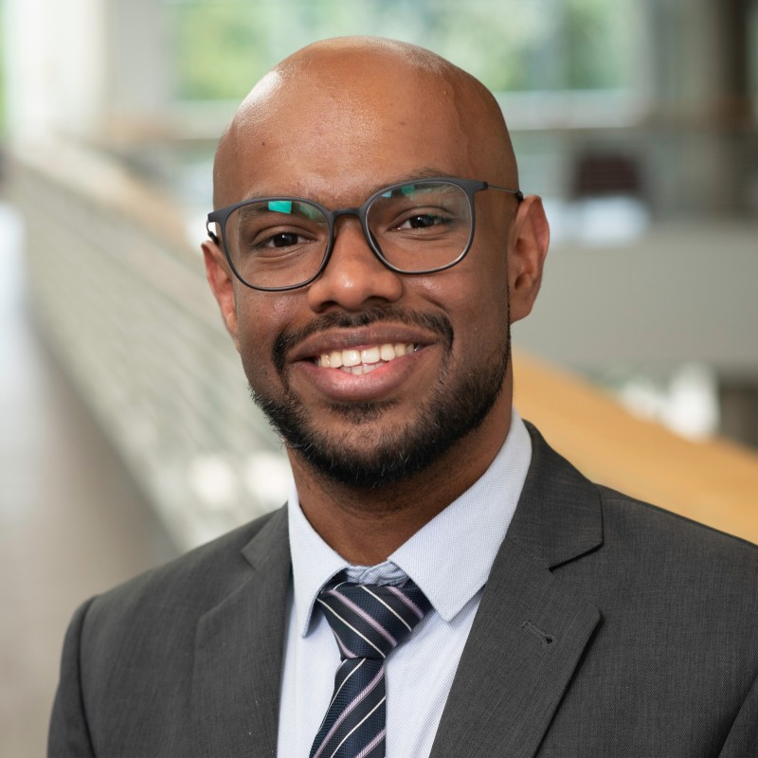

Thank You.
Raman Choudhary
Mohammed Shiran
Aditya Ravikrishnan
Justin
Varghese
Arjun Thonoor

Slide 22
Appendix
BIG BROTHER BIG SISTER

Slide 23


Closure Reasons Mapping
Original | Mapped Closure Reason
COVID impact | COVID Impact
Child: Lost interest, Child: Family structure changed, Child: Severity of challenges, Child: Changed school/site | Child/Family Changed Circumstances
Volunteer: Lost contact with child/agency, Child/Family: Lost contact with agency, Child/Family: Lost contact with volunteer/agency, Child/Family: Lost contact with volunteer, Volunteer: Lost contact with agency, Volunteer: Lost contact with child/family | Lost Contact
Volunteer: Changed workplace/school partnership, Changing Match Type | Relocation/Move
Volunteer: Infraction of match rules/agency policies, Volunteer: Unrealistic expectations, Agency: Challenges with program/partnership, Child/Family: Unrealistic expectations, Child/Family: Infraction of match rules/agency policies, Agency: Concern with Volunteer re: child safety | Policy/Expectation Issues
Successful match closure, Child: Graduated | Positive/Planned Closure
Child/Family: Feels incompatible with volunteer, Volunteer: Feels incompatible with child/family | Relationship Incompatibility
Volunteer: Moved, Child/Family: Moved, Child/Family: Moved out of service area, Volunteer: Moved out of service area, Volunteer: Moved within service area, Child/Family: Moved within service area | Relocation/Move
Volunteer: Time constraint, Child/Family: Time constraints | Time Constraints
Volunteer: Health, Volunteer: Deceased | Volunteer Personal Reasons

